Slide 1
Lucky Unicorn Documentation
Reid Allison

Slide 2
Lucky Unicorn
Link to GitHub Repository: ReisinDTC/Lucky_Unicorn (github.com)
Links to Trello board / project management tools: [https://trello.com/b/RuPk8mNn/luckyunicorn]
Link to final version of your program: [Lucky_Unicorn/LU_final_version.py at main · ReisinDTC/Lucky_Unicorn (github.com)]
Ensure you have made these links ‘public’ so that they are open to anyone, including the marker. The link to your program is the final outcome of this whole project – your finished program.

Slide 3
Describe relevant Implications:
Additional rows can be added by clicking in the last cell and then using the Tab key
Relevant implication | Describe the implication and give an example
Functionality | Functionality is about that the programming works as expected.
Usability | Usability is about how easily the end user can get the program to do what it is suppose to do.
Aesthetics | Aesthetics is about the program’s overall appearance.
Social | The social implications of a computer program are about the affect it might have on users, the wider community, and society as a whole.
Future proofing | Future proofing is about making a program which is flexible and adaptable and easy to modify later if necessary .
Notes:
Additional rows can be added by clicking in the last cell and then using the Tab key

Slide 4
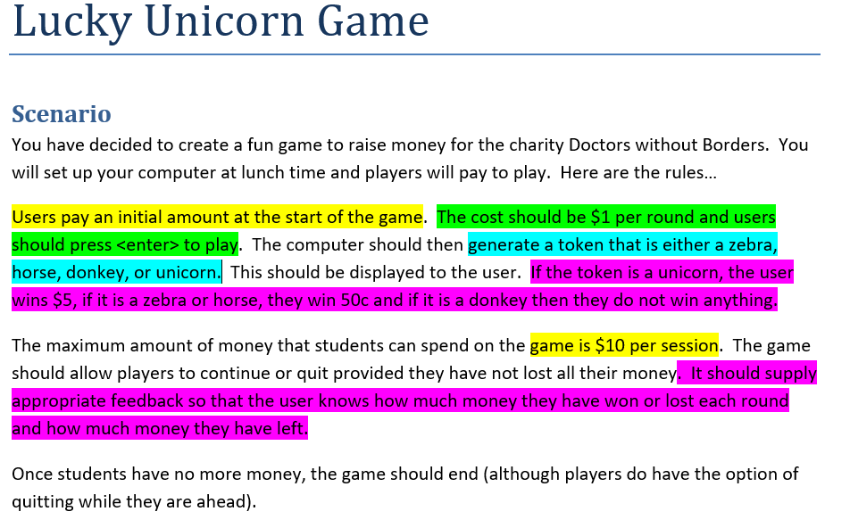
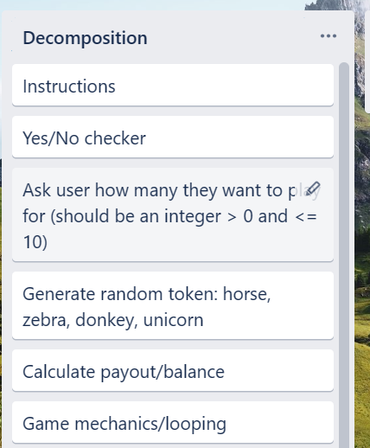
Decomposition:
Paste screenshots of your initial Trello board / task decomposition on this slide. If you have a long list, you might need to break it up into several slides.
Notes:
Paste screenshots of your initial Trello board / task decomposition on this slide. If you have a long list, you might need to break it up into several slides.

Slide 5
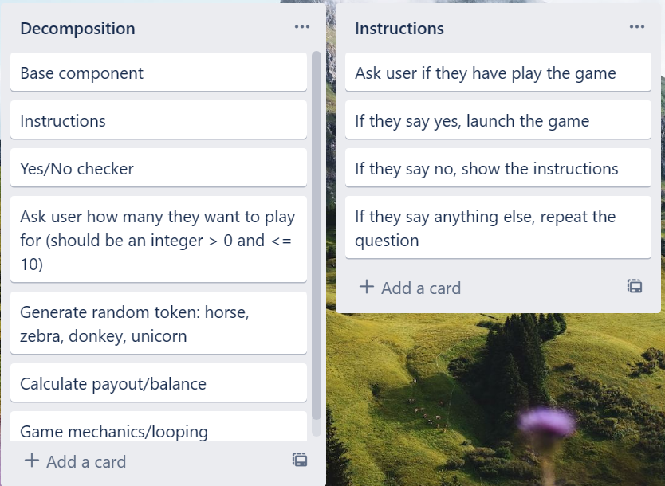
[Component 1 (Instructions and Yes/No checker)

Slide 6
[Yes/No checkers] - Test Plan
Additional rows can be added by clicking in the last cell and then using the Tab key
Test Cases - input | Expected output
yes | Program continues
Y | Program continues
No | Program continues
N | Program continues
Yes | Program continues
Maybe | Please enter either “Yes” or “No”
Notes:
Additional rows can be added by clicking in the last cell and then using the Tab key

Slide 7
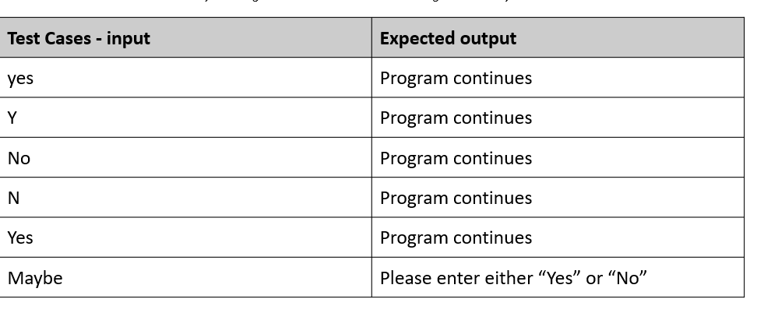
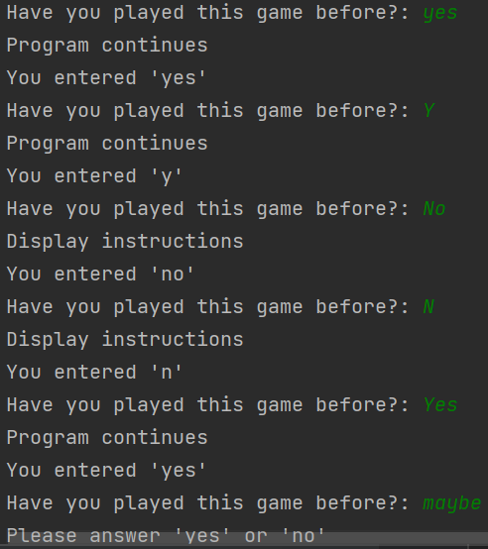
Yes/No checker - Testing
You must show the results of testing. For each component, include a screenshot proving it works. You can also include notes about each test.
Notes:
You must show the results of testing. For each component, include a screenshot proving it works. You can also include notes about each test.

Slide 8
Instructions- Test Plan
Additional rows can be added by clicking in the last cell and then using the Tab key
Test Cases - input | Expected output
Trial 1 01_yes_no_v1 | Program works but requires user to enter response using lower case. User also required to type “yes” or “no” and it won’t accept “y” or “n”
Trail 2 01_yes_no_v2 | Fixes the case problem and adds options for “y” and “n” prints results of valid input, prevents invalid input but quite cumbersome for testing
Trial 3 01_yes_no_v3 | Puts code into a loop – to make testing easier
Trial 4 02_yes_no_function_v1 | I made the code, from Trial 3 , into a function which makes it easy to recycle for other yes/no questions I might incorporate into my program. I will therefore use this function in my final program
Notes:
Additional rows can be added by clicking in the last cell and then using the Tab key

Slide 9
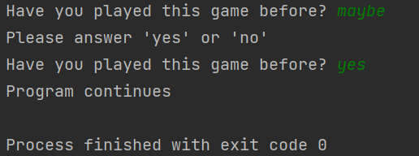
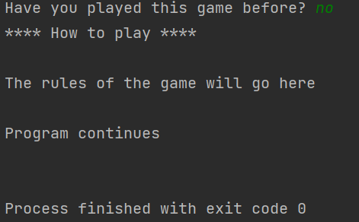
Instructions- Test Plan
Additional rows can be added by clicking in the last cell and then using the Tab key
Test Cases - input | Expected output
Have you played before? Maybe | <error> Please choose y/n
Have you played before? Yes | Game starts
Have you played before? No | Show instructions, then start the game
Notes:
Additional rows can be added by clicking in the last cell and then using the Tab key

Slide 10
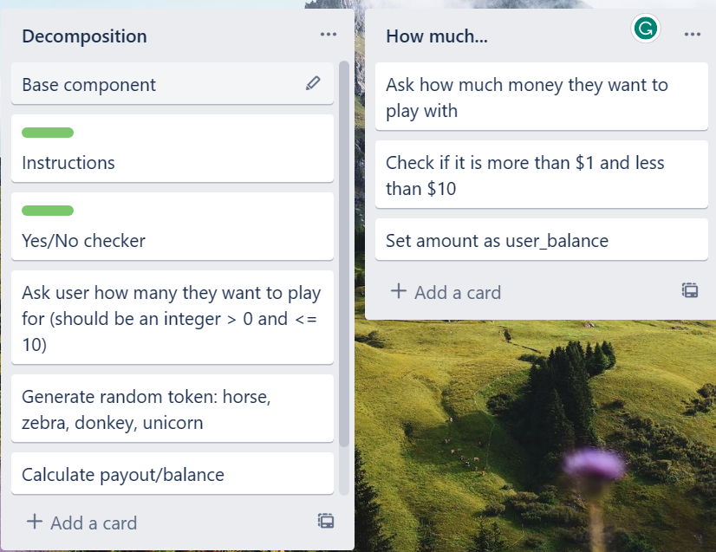
[Component name]: Trello screenshot
Notes:
NOTE: Trialling needs to happen for at least 2 of your components but is not necessary for ALL components.
Trialling is not the same as testing. Trialling is about finding different ways of building the same component. Show evidence of your trialling here. Select one of your trials for further development and give reasons for your choice.

Slide 11
[Yes/No checkers] - Test Plan
Additional rows can be added by clicking in the last cell and then using the Tab key
Test Cases - input | Expected output
Trial 1 04_how_much_v1 | Program works but only if the user enters integers. It correctly refuses integers outside the required range but crashes when invalid (string/float) data is entered
Trial 2 04_how_much_v2 | Program responds appropriately to invalid by refusing it without crashing and offering the user and opportunity to try again. However, the code is quite long and could be made efficient.
Trial 3 04_how_much_v3 | In this 3rd trial I included the valid range (1-10) as the basis of the while loop which eliminated the need to use the ‘valid’ variable. The result is more efficient yet every bit as adaptable for recycling as Trial 2.
Trial 4 04_how_much_v4
Notes:
Additional rows can be added by clicking in the last cell and then using the Tab key

Slide 12
[Yes/No checkers] - Test Plan
Additional rows can be added by clicking in the last cell and then using the Tab key
Test Cases - input | Expected output
Trial 4 04_how_much_v4 | Changed v3 into a function. Made user_balance a more generic variable name ‘response’ and changed the condition and position of the number comparison into the loop to make the function recyclable. I will adopt this one in my final program
Notes:
Additional rows can be added by clicking in the last cell and then using the Tab key

Slide 13
Assembled Outcome Testing:
Show testing for your assembled outcome below. This should include a test plan followed by screenshot proof.
Notes:
Show testing for your assembled outcome below. This should include a test plan followed by screenshot proof.

Slide 14
[Yes/No checkers] - Test Plan
Additional rows can be added by clicking in the last cell and then using the Tab key
Test Cases - input | Expected output
xxii | <error>Please enter a whole number between 1 and 10
0.5 | <error>Please enter a whole number between 1 and 10
0 | <error>Please enter a whole number between 1 and 10
11 | <error>Please enter a whole number between 1 and 10
1 | Program continues
10 | Program continues
Notes:
Additional rows can be added by clicking in the last cell and then using the Tab key

Slide 15
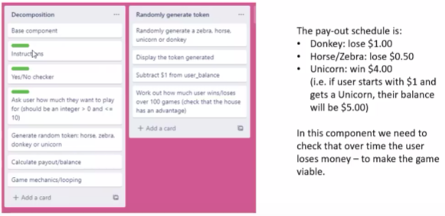
Component 3: (Generate random token)
NOTE: Trialling needs to happen for at least 2 of your components but is not necessary for ALL components.
Trialling is not the same as testing. Trialling is about finding different ways of building the same component. Show evidence of your trialling here. Select one of your trials for further development and give reasons for your choice.
Notes:
NOTE: Trialling needs to happen for at least 2 of your components but is not necessary for ALL components.
Trialling is not the same as testing. Trialling is about finding different ways of building the same component. Show evidence of your trialling here. Select one of your trials for further development and give reasons for your choice.

Slide 16
[Yes/No checkers] - Test Plan
Additional rows can be added by clicking in the last cell and then using the Tab key
Test Cases - input | Expected output
Run the program | Program should output 20 tokens with at least one each of: Horse, donkey, zebra and unicorn. The order of the tokens must be random.
Notes:
Additional rows can be added by clicking in the last cell and then using the Tab key

Slide 17
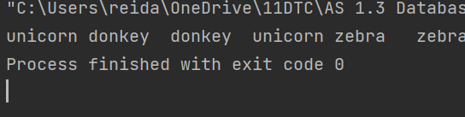

Test Plan: tokens randomly generated
Additional rows can be added by clicking in the last cell and then using the Tab key
Test Cases - input | Expected output
User starts with $100 Run program | User should I lose money (final balance should be less than $100)
Notes:
Additional rows can be added by clicking in the last cell and then using the Tab key

Slide 18
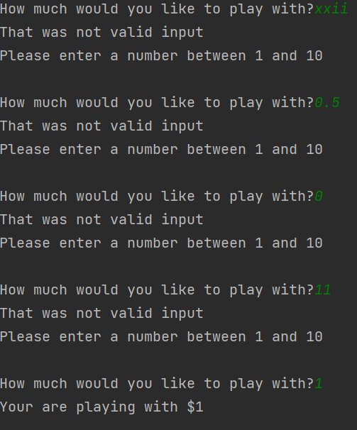

How much - Testing
Notes:
Show testing for your assembled outcome below. This should include a test plan followed by screenshot proof.

Slide 19
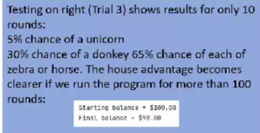
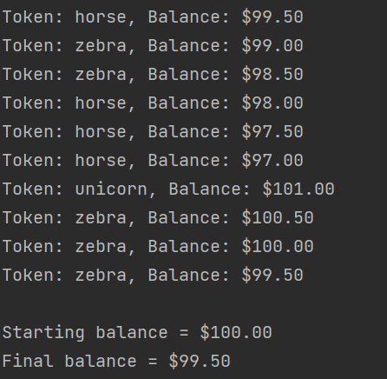
Generate random token - Testing
Notes:
Show testing for your assembled outcome below. This should include a test plan followed by screenshot proof.

Slide 20
Generate random tokens: Trialling
Additional rows can be added by clicking in the last cell and then using the Tab key
Test Cases - input | Expected output
Trial 1 05_token_generator_v2 | This program chooses from a list of 'horse', 'unicorn', 'donkey' and 'zebra'. When run 100 times, it became clear that the house would lose money instead of making it.
Trial 2 05_token_generator_v3 | In this trial I changed the list so that there were 10% unicorns and 30% of each of the other (1 unicorn and 3 each of the others). This did give the house an advantage.
Notes:
Additional rows can be added by clicking in the last cell and then using the Tab key

Slide 21
Generate random tokens: Trialling
Additional rows can be added by clicking in the last cell and then using the Tab key
Test Cases - input | Expected output
Trial 3 05_token_generator_v4 | In my third trial, instead of choosing items form a list, I chose a random integer between 1 and 100. The schedule was set up so that users had a 5% chance of getting a unicorn, a 30% chance of getting a donkey and a 65% chance of getting a horse or zebra. For this last 65% it awarded horse or zebra depending whether or not the number generated was even (horse) or odd (zebra)
Notes:
Additional rows can be added by clicking in the last cell and then using the Tab key

Slide 22
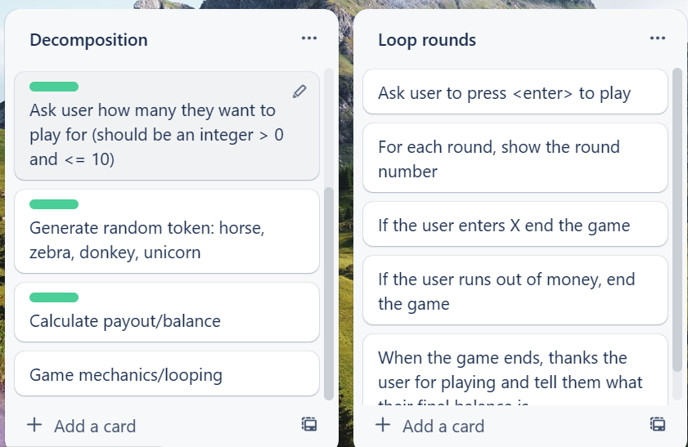
Game mechanics and looping
Notes:
Show testing for your assembled outcome below. This should include a test plan followed by screenshot proof.

Slide 23
Test Plan: Game mechanics and looping
Additional rows can be added by clicking in the last cell and then using the Tab key
Test Cases - input | Expected output
User starts with $5 User continues playing until the money runs out | Game should go for 5 rounds. Each round should be correctly numbered After 5 rounds it should display 'Sorry you have run out of Money'
Starting amount $5 User plays 3 rounds and then exits | Game should go for 3 rounds When user enter 'X' the game should end Final balance should be $2
Notes:
Additional rows can be added by clicking in the last cell and then using the Tab key

Slide 24
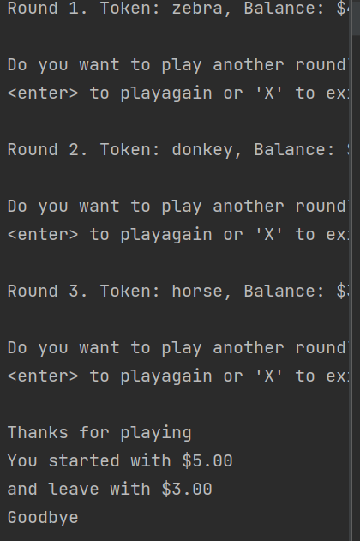
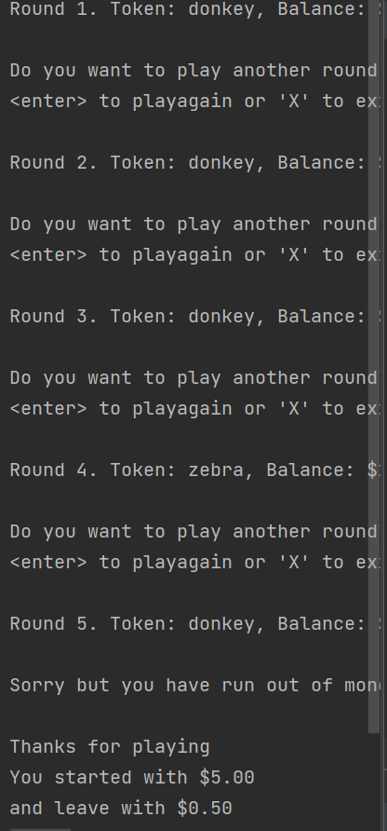
Game mechanics and looping
Notes:
Show testing for your assembled outcome below. This should include a test plan followed by screenshot proof.

Slide 25
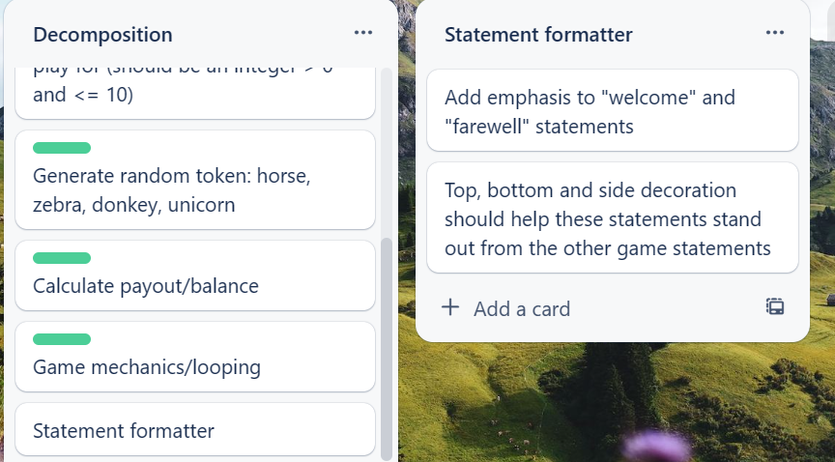
Statement formatter
Notes:
Show testing for your assembled outcome below. This should include a test plan followed by screenshot proof.

Slide 26
Test Plan: Statement formatter
Additional rows can be added by clicking in the last cell and then using the Tab key
Test Cases - input | Expected output
Statement 1: "Welcome to the lucky Unicorn Game" Decoration: "*" | --------------------------------------------------------- ----Welcome to the Lucky Unicorn Game---- ---------------------------------------------------------
Statement 2: "Congratulations, you got a Unicorn" | !!!!!!!!!!!!!!!!!!!!!!!!!!!!!!!!!!!!!!!!!!!!!!!!!! !!! Congratulations, you got a Unicorn!!! !!!!!!!!!!!!!!!!!!!!!!!!!!!!!!!!!!!!!!!!!!!!!!!!!!
Statement 3: "Goodbye" | *********** **Goodbye** ***********
Notes:
Additional rows can be added by clicking in the last cell and then using the Tab key

Slide 27
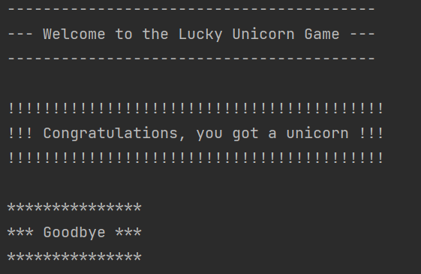
Statement formatter
Notes:
Show testing for your assembled outcome below. This should include a test plan followed by screenshot proof.

Slide 28
Test Plan: Assembled outcome
Additional rows can be added by clicking in the last cell and then using the Tab key
Test Cases - input | Expected output
Run program Played before = maybe Played before = No | Welcome message displays Error – please answer yes or no Instructions display
Enter amount to play with: Xlii 0.5 0 11 1 | Error Error Error Error You are playing with $1. Press <enter> to start
Notes:
Additional rows can be added by clicking in the last cell and then using the Tab key

Slide 29
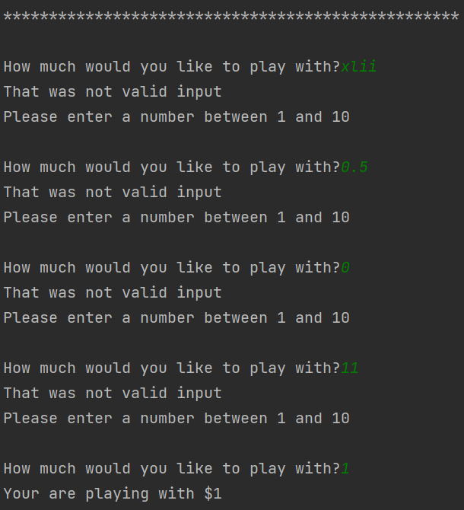
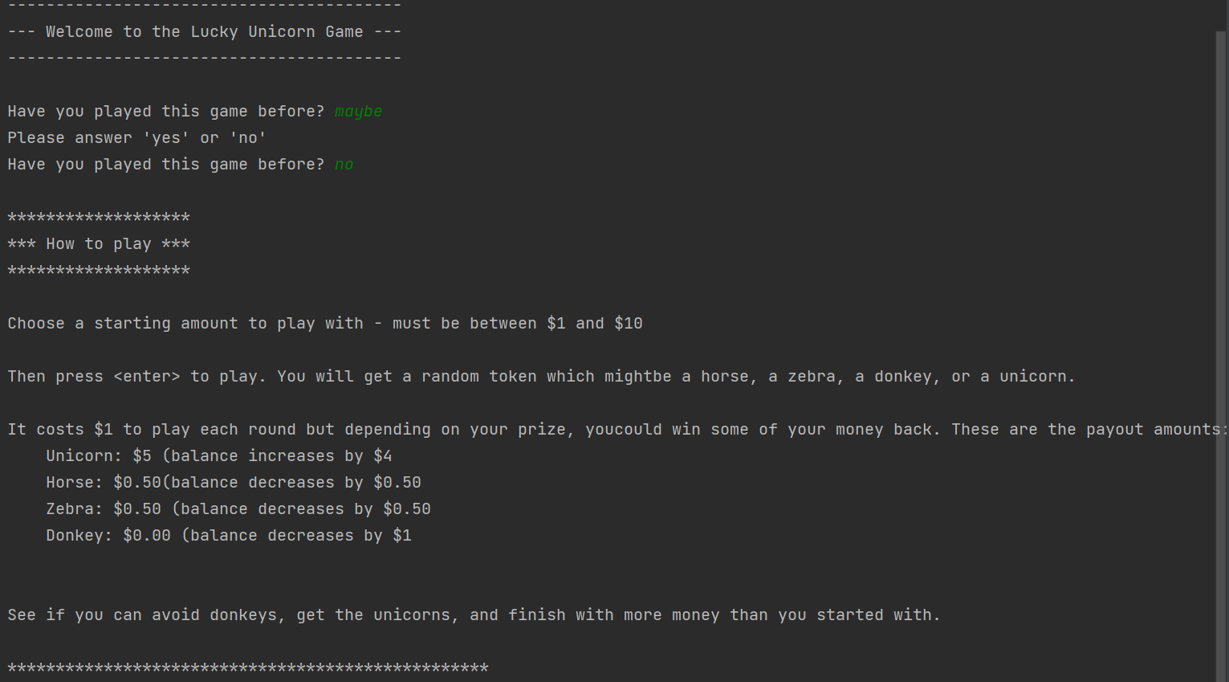
Statement formatter
Notes:
Show testing for your assembled outcome below. This should include a test plan followed by screenshot proof.

Slide 30
Test Plan: Assembled outcome 2
Additional rows can be added by clicking in the last cell and then using the Tab key
Test Cases - input | Expected output
Play with $1 until money runs out | For each round: Random token generated Balance and round number updated At end: Stats generated showing starting amount of $1 and final balance of $0.50 or $0.00
Run program Played before = yes Amount to play with = 10 | Welcome message displays No Instructions displayed
Notes:
Additional rows can be added by clicking in the last cell and then using the Tab key

Slide 31
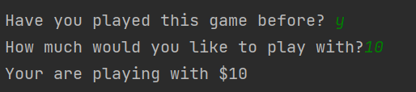
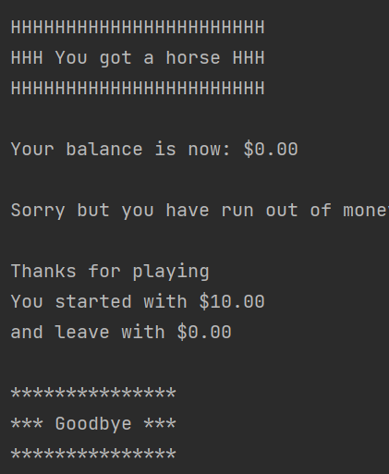
Statement formatter
Notes:
Show testing for your assembled outcome below. This should include a test plan followed by screenshot proof.

Slide 32
Test Plan: Assembled outcome 3
Additional rows can be added by clicking in the last cell and then using the Tab key
Test Cases - input | Expected output
Play until balance is $3.00/$2.50, then 'X' to quit | For each round: Random token generated Balance and round number update (lose $1 for donkeys, lose $0.50 for a horse of a Zebra, and gain $4 for any Unicorn At end: Stats generated showing starting amount of $10 And final balance of $2.50 or $3.00
Notes:
Additional rows can be added by clicking in the last cell and then using the Tab key

Slide 33
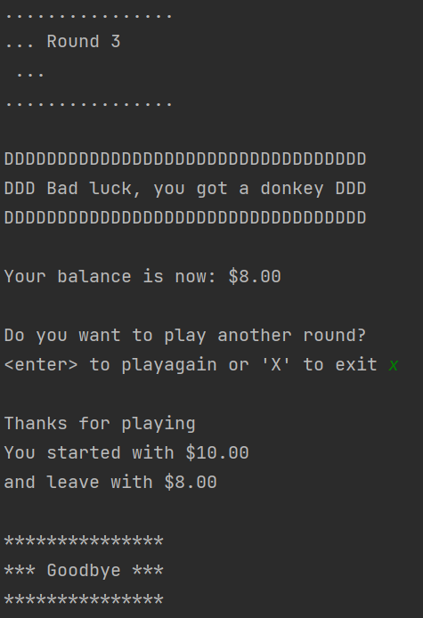
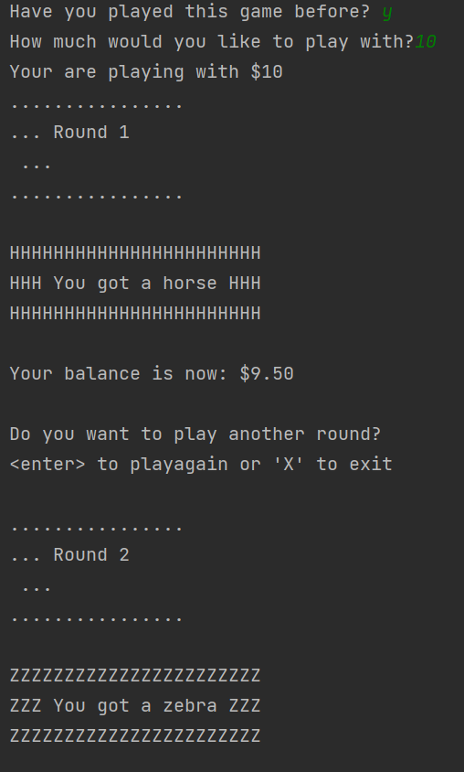
Statement formatter
Notes:
Show testing for your assembled outcome below. This should include a test plan followed by screenshot proof.

Slide 34
Address relevant Implications:
Relevant implication | Explain how your final outcome addresses each implication
Functionality | I have comprehensively tested my outcome to ensure that the functionality implication has been address (i.e. it works for expected, unexpected and boundary values).
Usability | The inclusion of optional instructions and clear error messages helps to make the outcome easy to use.
Aesthetics | I have carefully spaced the program's output and used a statement generator to enhance it appearance.
Social | My program has a $10 limit on the amount users can spend.
Future proofing | I avoided the use of literals and used functions to make my code flexible and easy to modify later if necessary.

Slide 35
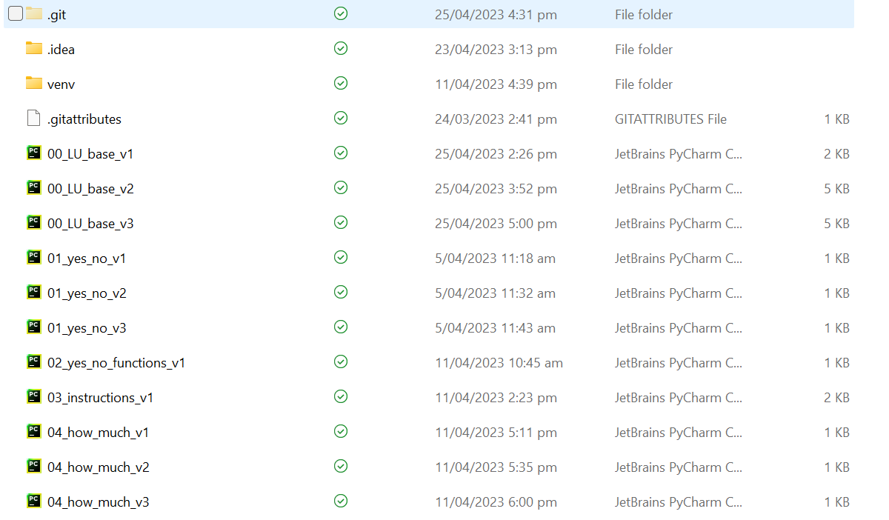
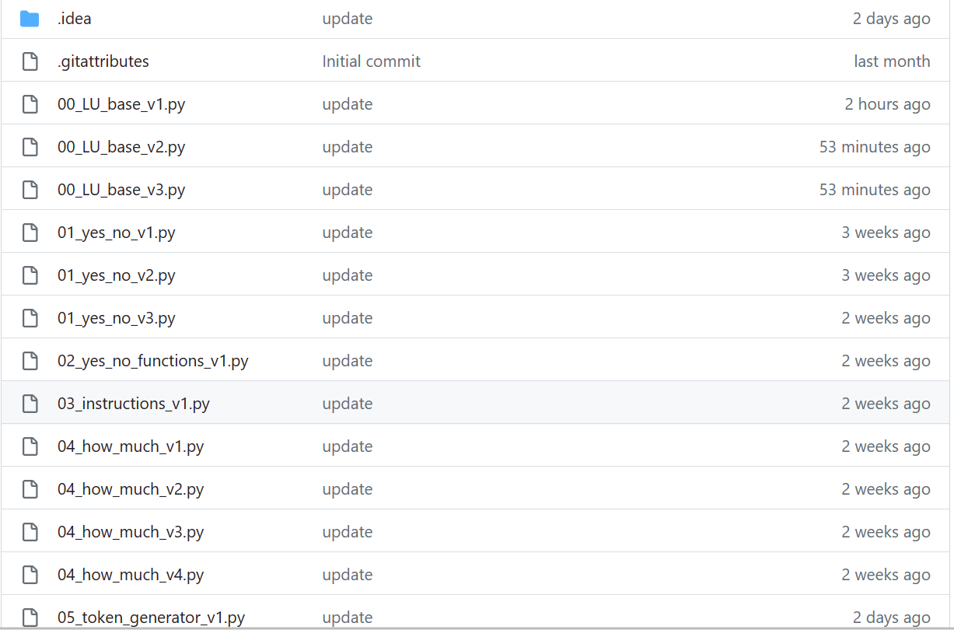
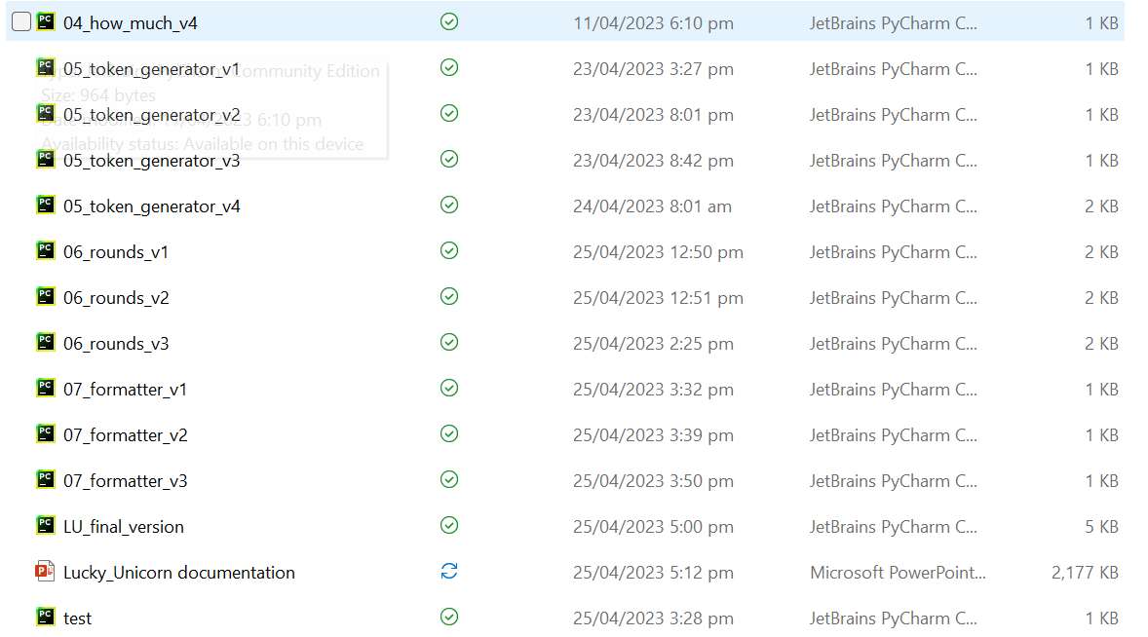
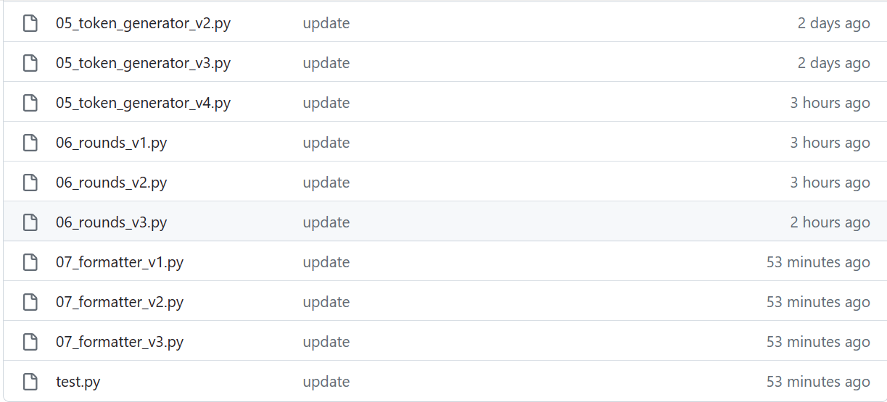
Version Control Evidence:
Your version control evidence should go here. This could be in the form of screenshots (both of your GitHub repository as well as your local project folder) as evidence of your incremental development.
Notes:
Your version control evidence should go here. This could be in the form of screenshots (both of your GitHub repository as well as your local project folder) as evidence of your incremental development.

Slide 36
Final Discussion:
Discuss how the information from planning, testing and trialling of components assisted in the development of a high-quality outcome.
Notes:
Discuss how the information from planning, testing and trialling of components assisted in the development of a high-quality outcome.

